Slide 1

Encedo Limited
CyLon, March 2015

Slide 2
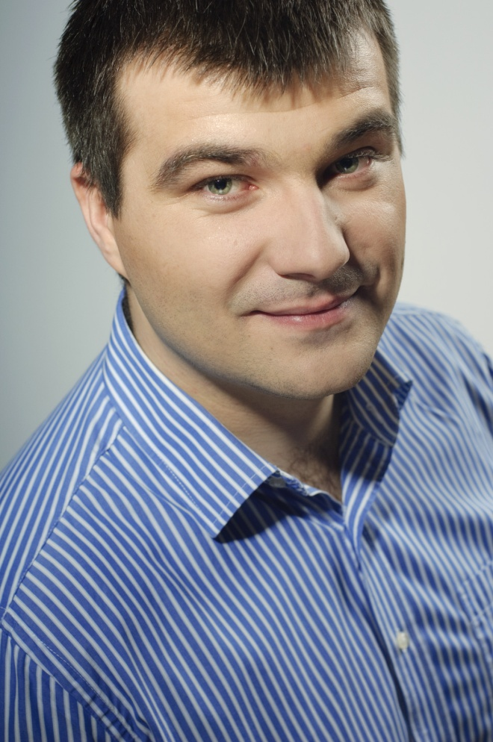
Presenter
Krzysztof Rutecki
CEO, @ Encedo Limited

Slide 3


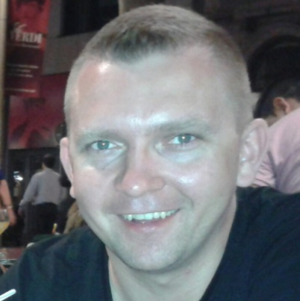
OUR TEAM
hardware & firmware
webservices
Krzysztof Rutecki
Maciej Kupisiewicz
operations
Remigiusz Rynkowski

Slide 4

PRESENTATION PLAN
What is the problem?
What is the problem cost?
Is there a solution?
There is a hope!
What are the benefits?

Slide 5

PROBLEM DEFINITION
How to manage online privacy? Not an easy task!
.. so users don`t care!
Available solutions are for professional only.
Simple solutions for encryption and authentication online is needed.

Slide 6
PROBLEM DEFINITION
More details
How to manage online privacy? Not an easy task!
.. so users don’t care!
Available solutions are for professional only.
Simple solutions for encryption and authentication online is needed.
Simple passwords are in use, files send unencrypted over email/cloud storage.
Encrypted USB Flash Drive seems to be secure (but is not)!
PGP (GPG) is complicated, SMIME not popular (certs are expensive).
Available hardware solutions can’t be use on web directly.

Slide 7
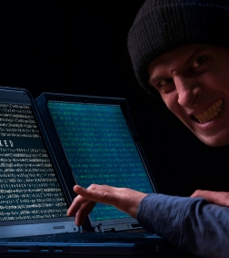
PROBLEM COST
High impact in case of login/password leakage (2014 is a record year. *
Only SSL/TLS available for data protection client-server.
No end-to-end encryption.
Data are easy readable (ISP, GOV, web operator etc).
* by Ars Technica

Slide 8

EncedoKey Personal Privacy Assistant

Slide 9
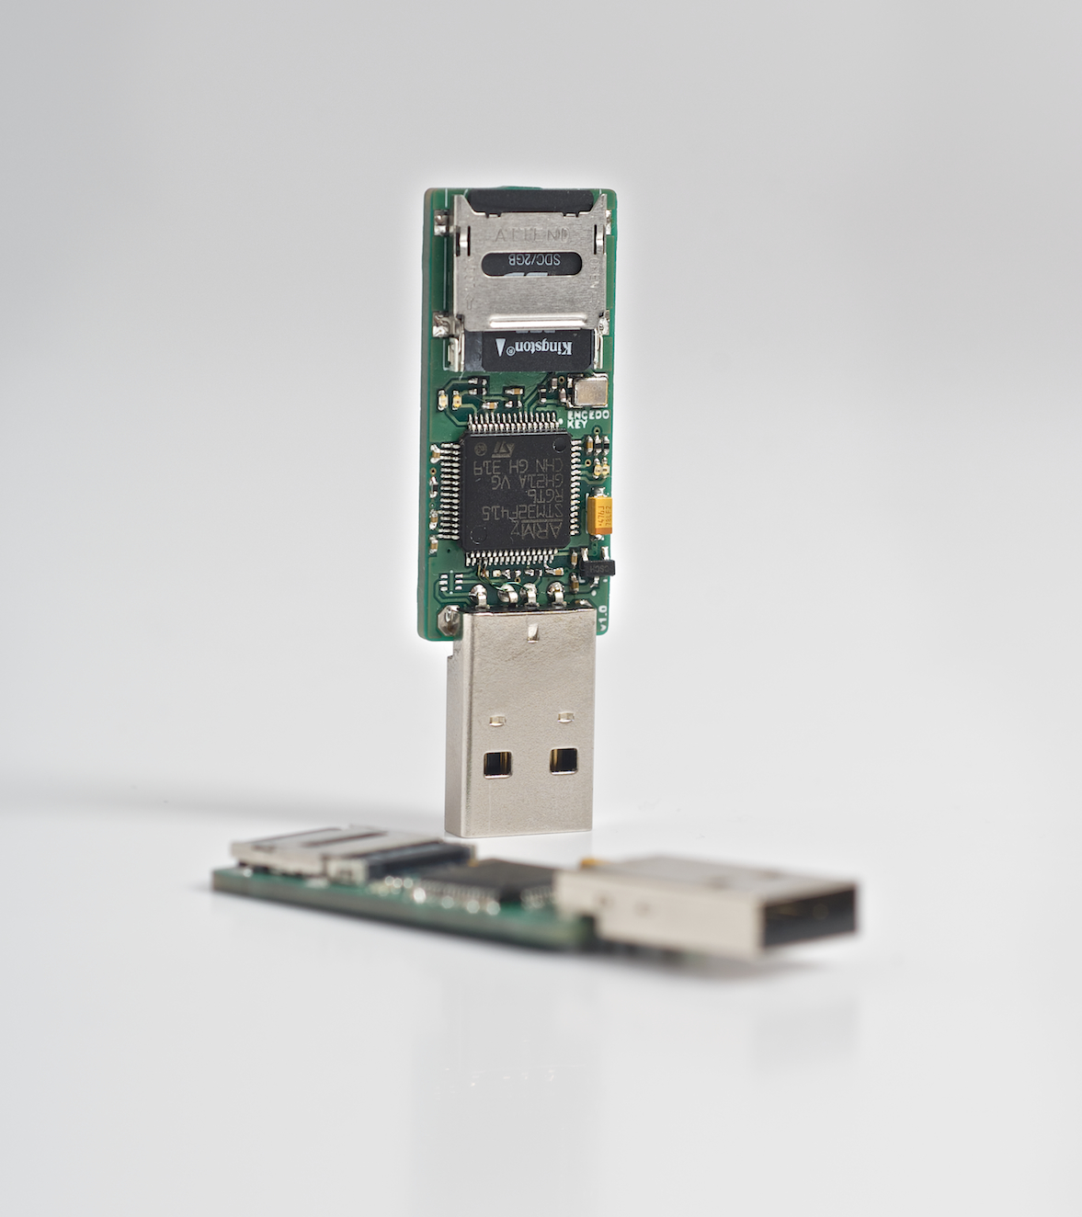
SOLUTION
Ordinary USB stick size device.
Encrypted storage (with hidden-volume).
Encryption/Decryption
of files and messages on the fly.
Authenticator.

Slide 10
SOLUTION
More details
RESTful API (Ethernet Interface).
Oriented on Web technology.
Easy integration.
Modular design, easy to expand.
It’s open source! Trust in transparency.
Single chip (ARM Cortex-M).
High speed (~40ops on 256bits ECC key).
Flexibility.

Slide 11
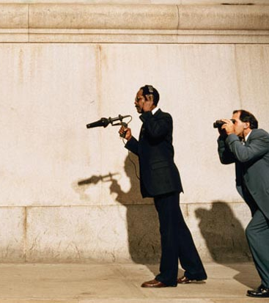
ADDRESSABLE MARKET
Why now?
We live in post Snowden era - climate is good!
... so what next?
The ones who want to use e.g. PGP do not know how? *
With simple solution people will be encouraged to protect their online privacy.
* Glenn Greenwald

Slide 12

ADDRESSABLE MARKET
For whom?
Absolutely everyone! It’s simple like using USB Flash Drive.
Professional (lawyers, photographers, accountant etc) –they carry data in the pocket.
Companies (banks, corporations etc) – need to authenticate and exchange confidential information securely.
Regular user – forget about week passwords (forget about password at all).

Slide 13
COMPETITORS
YUBICO
Authentication only.
Requires middleware.
Partially open source.
SMART CARD
Complicated in use (drivers, installations).
Weak cryptography (2048 RSA most, one company gives 4096 bits).
Slow (0.7 ops for 4096bits).
Require full trust!
TPM
It’s a silicon/chip, need to be embedded (e.g. in laptops).
RSA up to 2048 bits only.
Quite slow (5 ops for verify sign, the faster chip from Atmel).
Require full trust!

Slide 14
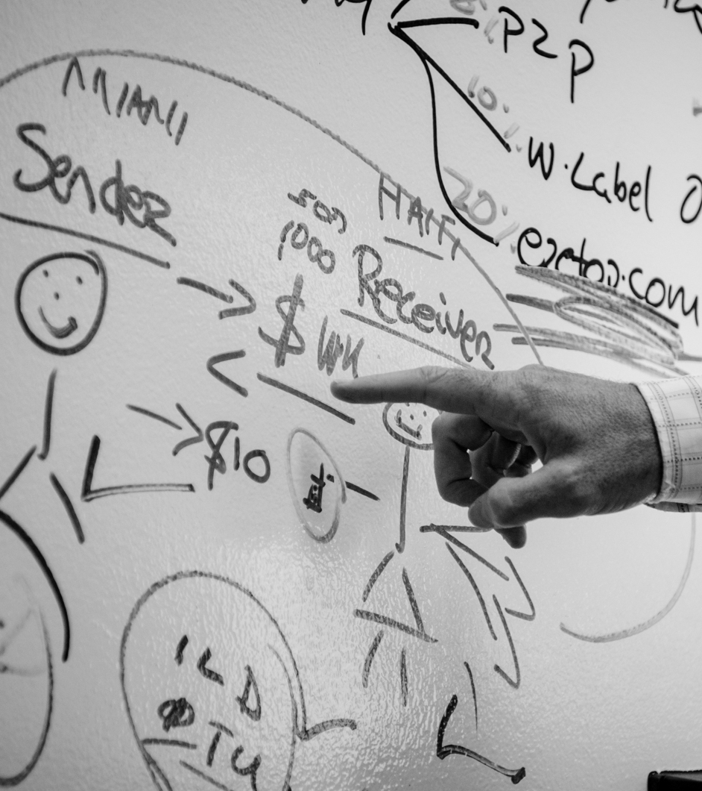
BENEFITS FROM CYLON
Networking!
Priceless advice, outstanding opinions from professional.
Business growth & development direction.
Fund raising.

Slide 15
"Simplicity is the ultimate sophistication."
by Leonardo da Vinci

Slide 16
SUMMARY
PROBLEM
COST
SOLUTION
BENEFITS
How to manage online privacy? Not an easy task!
Simple passwords are in use, files send unencrypted over email or cloud.
Ordinary USB stick size device to provide online privacy.
Simple, easy to use solutoins for everyone. Keep calm and fill free.

Slide 17
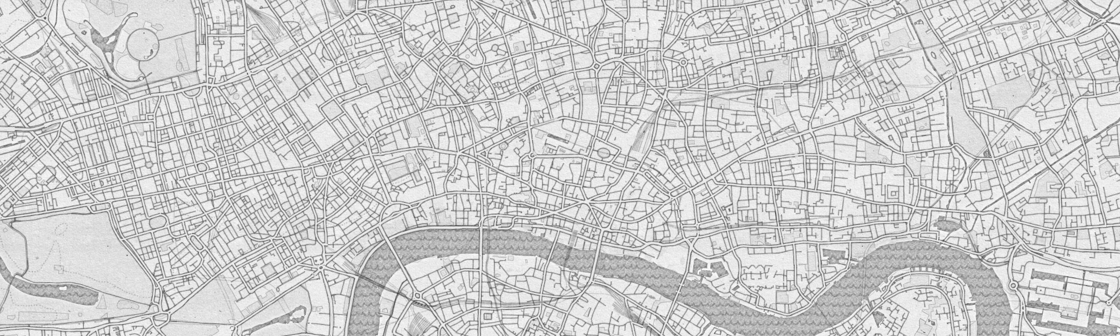
CONTACT
Visit Us
e-mail
Call Us
86-90 Paul Street,
EC2A 4NE, London, UK
office@encedo.com
krzysztof@encedo.com
+44 785 1821395
+44 203 6955391

